Slide 1
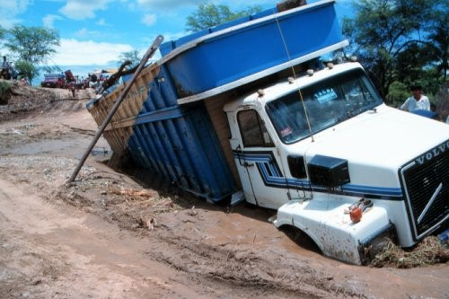
The Muddiest Point
Where did you get stuck this lesson? How can we become unstuck and get out of the mud?

